Slide 1
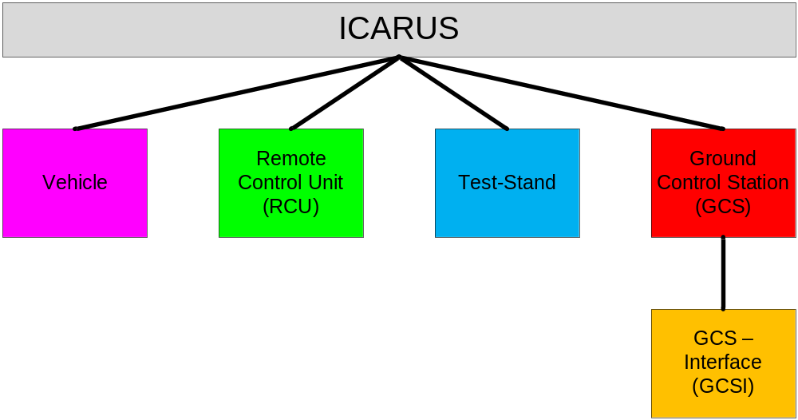

ICARUS System Description
Integrated Complex Advanced Robotic Unmanned System

Slide 2
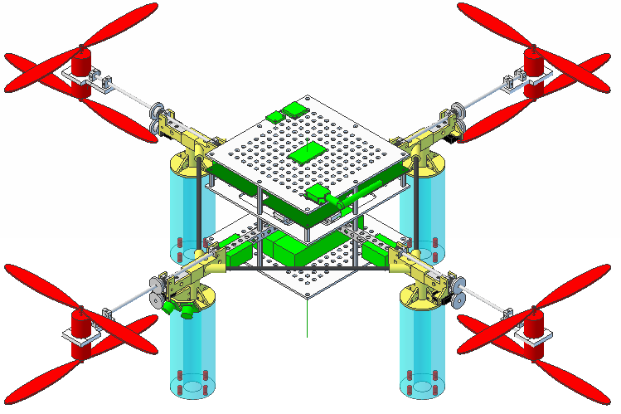
ICARUS Vehicle
Rapid Prototype Parts
Field Replaceable Units
ICARUS Vehicle supports Spiral 6 thru Field Replaceable Units – Any pylon can be removed/installed quickly using a universal connector.
Integrated Complex Advanced Robotic Unmanned System

Slide 3
ICARUS Technologies
Technologies - Planned
Command/Control Network Monitoring | Inertial Navigation Unit (INU) w/ Altitude and Heading Reference System (AHRS)
Power Management | Primary/Secondary Controller Implementation
Waypoint Navigation | Communications Protocol
Co-Axial Rotors | Tilt Rotors
Technologies - Future
3d Feedback | Audio Commands
Automatic Landing Pad | Cellular Network
Cel-Phone Control | Target Detection
Data Storage | GCS Interface (MATLAB)
JAUS Interoperability | Motor Heat Dissipation
R/C Control | RCU Testing Software
Recovery System | Wireless Charging
Satellite Communications | Simultaneous Localization and Mapping (SLAM)
Integrated Complex Advanced Robotic Unmanned System

